Slide 1
Statistical modelling of music features
AMAN KHARWAL
5 June 2024
Notes:
- Demo
- Not polished in-depth

Slide 2
Agenda
Statistical modelling vs ML model training
The dataset
Results - Analysis
Final notes - Improvements

Slide 3
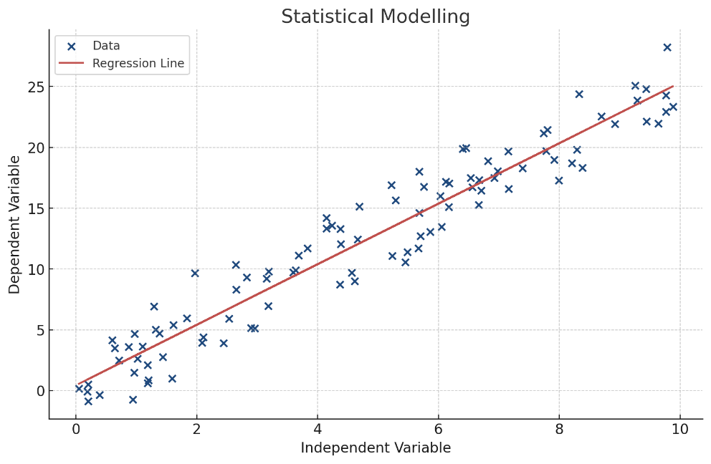
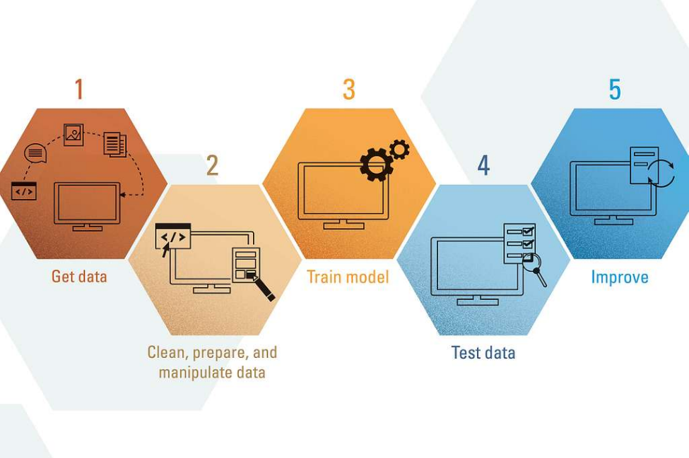
Statistical modelling vs ML model training
Mathematical framework used to describe the relationships between variables.
The primary goal is to create models that can make accurate predictions on new, unseen data.
Notes:
-The difference is that statistical modelling is primarily concerned with inference.
-It seeks to understand the underlying relationships between variables and to quantify how predictors influence the response variable.
-Whereas MLmt focuses on prediction.
-Machine learning often cares less about the ‘why’ of the data relationships and more about the ‘how well’ it can predict the outcome.

Slide 4

Statistical modelling of music features
Danceability
Energy
Loudness
Acousticness
Valence
Explicit
Key
Mode
Speechines
Instrumentalness
Tempo
Notes:
To explain the use of statistical modelling, I’ll take you through a statistical model of music features, where it was aimed to identify what music features make music tracks popular.

Slide 5
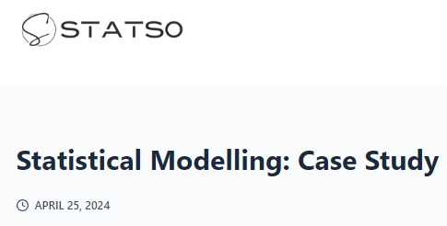
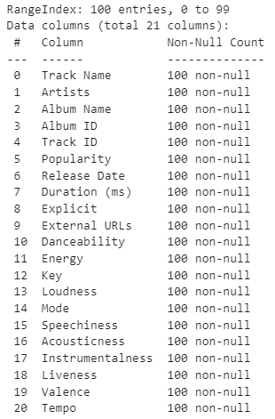
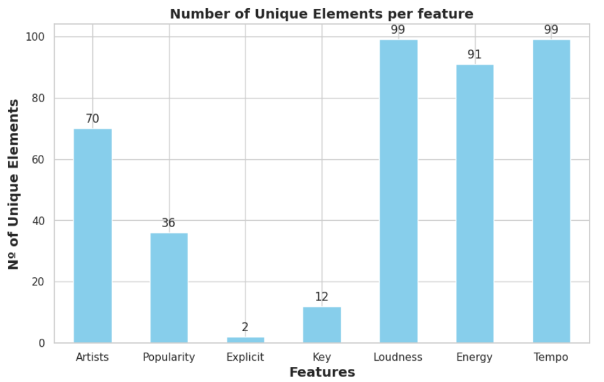
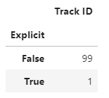
The Dataset
https://statso.io/statistical-modelling-case-study/
Notes:
Publicly available
100 entries
Variety. Main, Explicit, Keys and Features
- Explicit observation

Slide 6
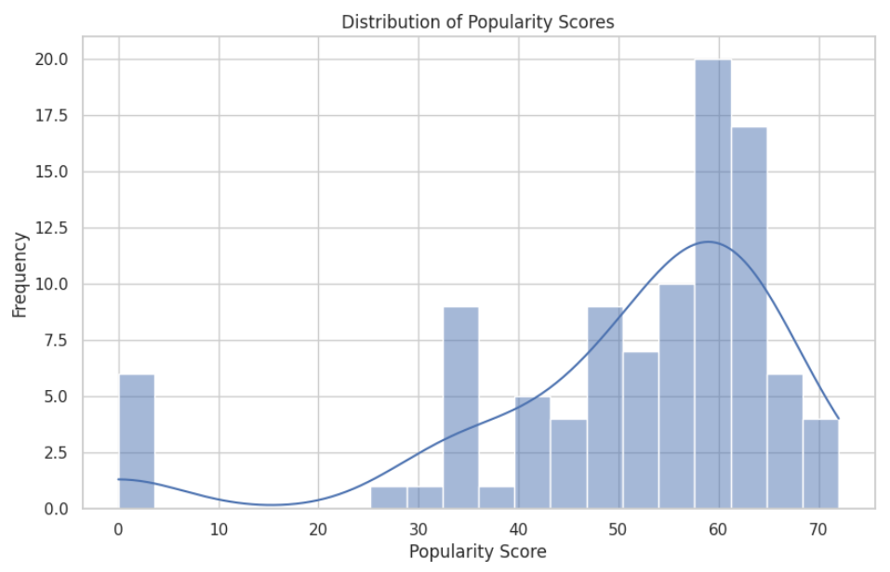
Distribution of popularity
Range [40, 70]
Peaks 35, 50 & 60
Empty [0, 30]
Moderate to high popularity
Notes:
- We notice / it shows that / it is evident

Slide 7
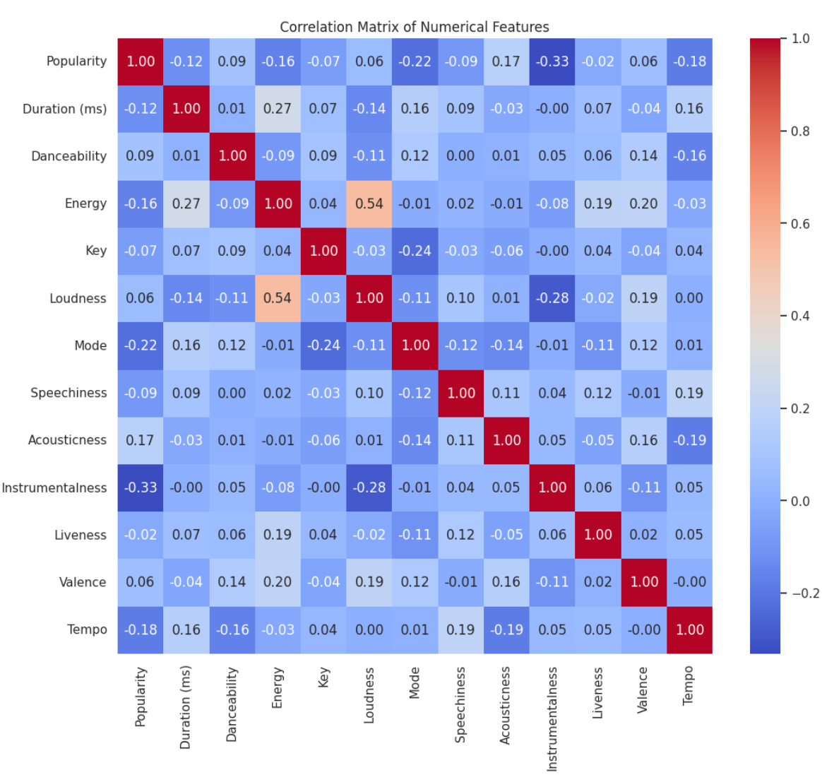
Correlation Matrix
Positive correlation
Negative correlation
Loudness
Energy
Acousticness
Energy
Danceability
Valence
Instrumentalness
Mode
Acousticness
Notes:
The heatmap provides insights into how various features are related to each other and the popularity of the tracks.
+ Loudness & Energy
- Acousticness => suggests
- + Danceability & Valence (positiveness)
Loudness OK, Energy negative
Acousticness positive
Point out -> Instru & Mode

Slide 8
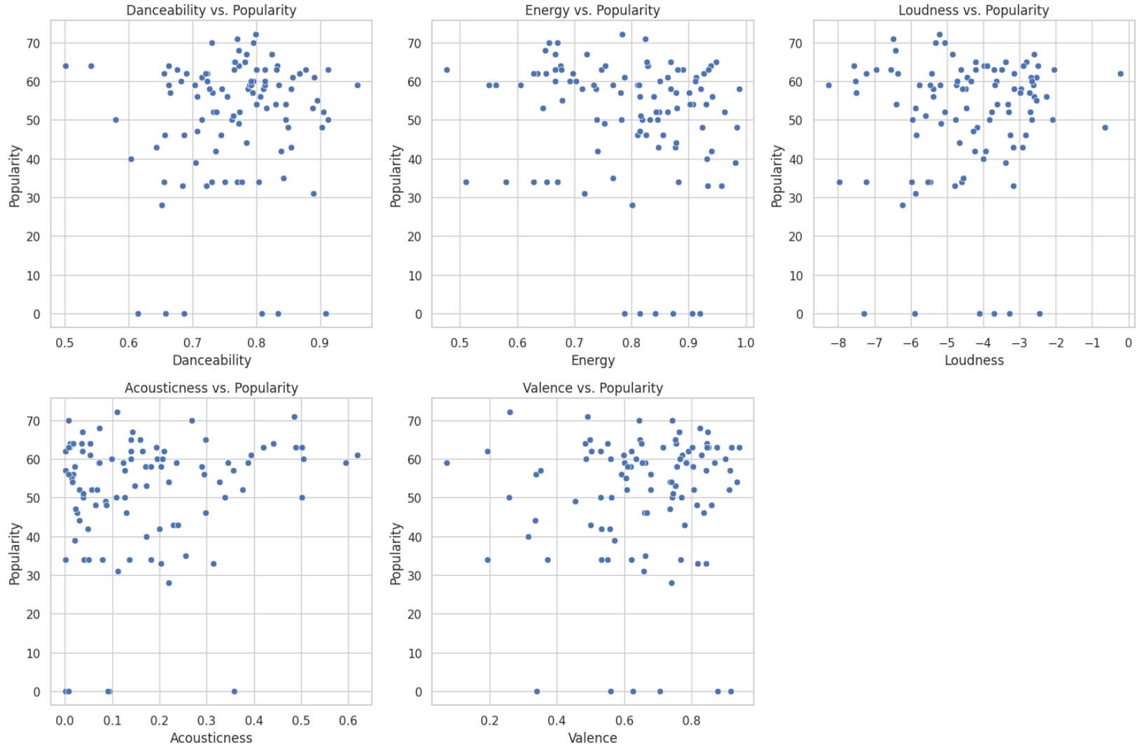
Notes:
Scatter

Slide 9
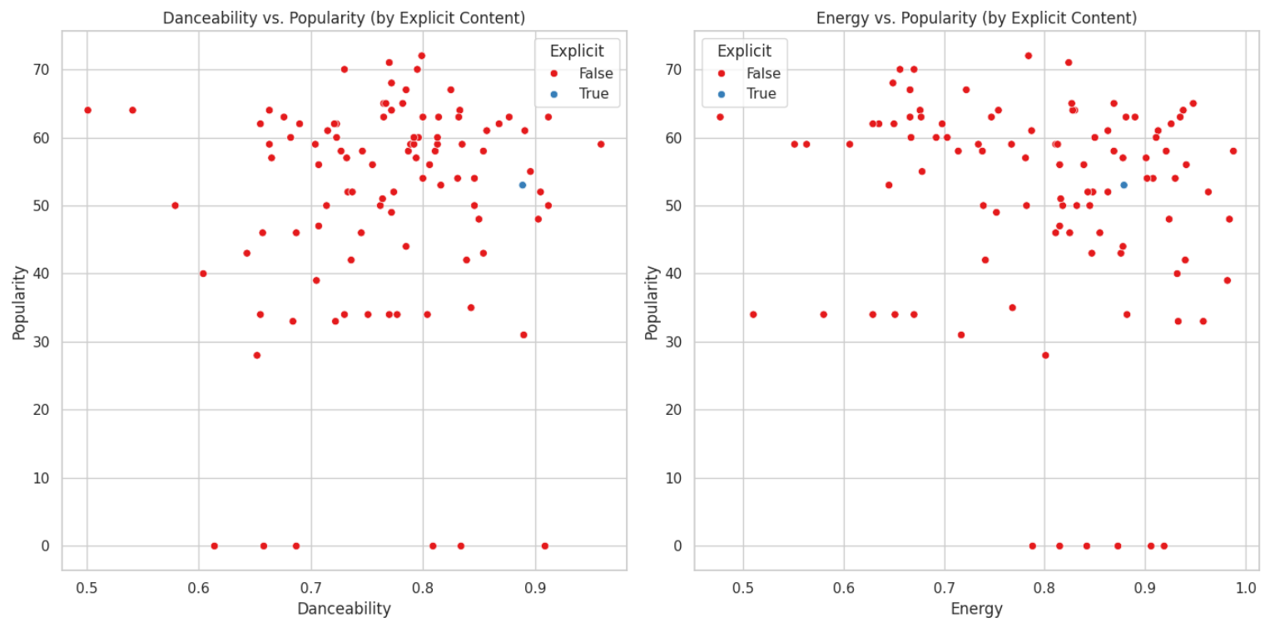
Notes:
Both show + trend danceability
It’s said that + relationship & Explicit appear to achieve higher popularity at lower energy levels compared to non explicit.
Suggests expl appeal + irrespective energy lvl

Slide 10
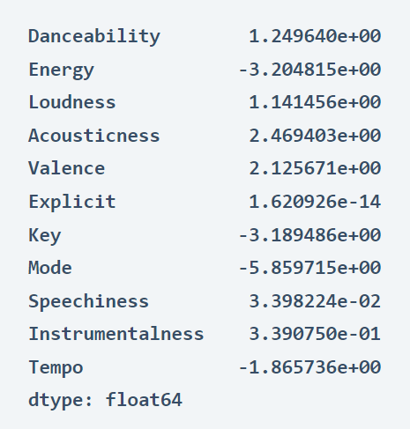
Linear regression model
Notes:
Now, let’s quantitatively assess the impact of various features on the popularity of music tracks using a regression model. This will allow us to understand which features are significant predictors of popularity, and quantify their impact.
The data above represent Coefficients (quanitify impact) + / - associated
+
-

Slide 11

Final notes - Improvements
- Bigger dataset
- Wider range of values
- Careful interpretation of data
- More precision
R2 ~ -0.37
Notes:
First 2 => Robust
Verify accuracy. Evaluation variables. Determination coefficient Pearson

Slide 12
Sources
All images have Creative Commons licenses, were made by AI or come from plots of this study.
Harnessing the Power of Machine Learning: A New Road to Rapid Drug Discovery - PICRYL - Public Domain Media Search Engine Public Domain Image (getarchive.net)
Improvements - Free of Charge Creative Commons Handwriting image (thebluediamondgallery.com)

Slide 13
Thank you
Jesús Ramos Rodríguez

